Slide 1
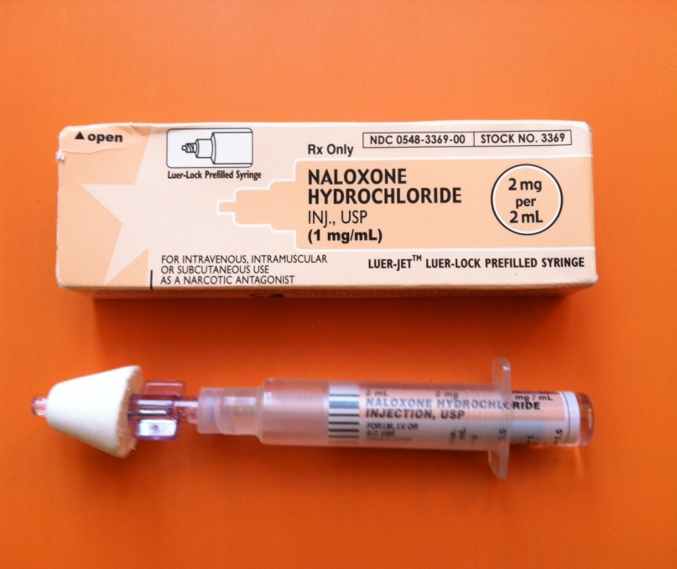
Do you take strong pain medications? For example: Percocet, Vicodin, methadone, oxycodone, morphine, MSContin, Dilaudid, fentanyl, or any other “opiate” medication?
Ask your provider for naloxone!!
Naloxone is an antidote sprayed into the nose if you are too sleepy or can’t be woken up due to these pain medications.
Talk to your provider for more information.

